Slide 1

CHURN Data analysis

Slide 2
DATABASE SCHEMA

Slide 3
OBJECTIVE
Predicting which set of the Customers are gong to churn out from the organization by looking into some of the important attributes and applying Machine Learning and Deep Learning on it.
Customer churn refers to when a customer ceases his or her relationship with a company. Online churned once a particular amount of time has elapsed since the customers last interaction with the site or service.
Customer churn occurs when customers or subscribers stop doing business with a company or service, also known as customer attrition. Its also referred as loss of clients or customers. Similar concept with predicting employee turnover, we are going to predict customer churn using telecom dataset.

Slide 4
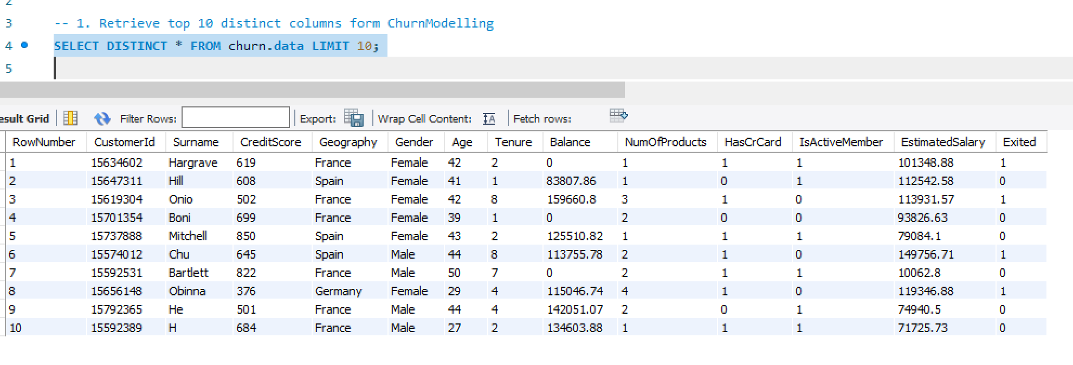
QUESTION NO : 1
Retrieve tope 10 distinct columns form Churn Modelling
Query:
SELECT DISTINCT * FROM churn.data LIMIT 10;
Method Used: SELECT STATEMENT

Slide 5
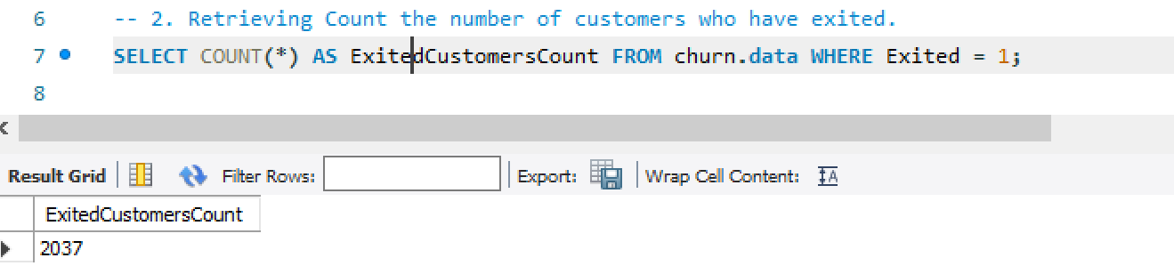
QUESTION NO: 2

Slide 6
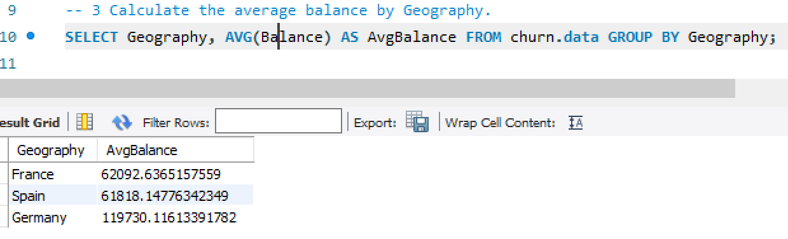
QUESTION NO: 3

Slide 7
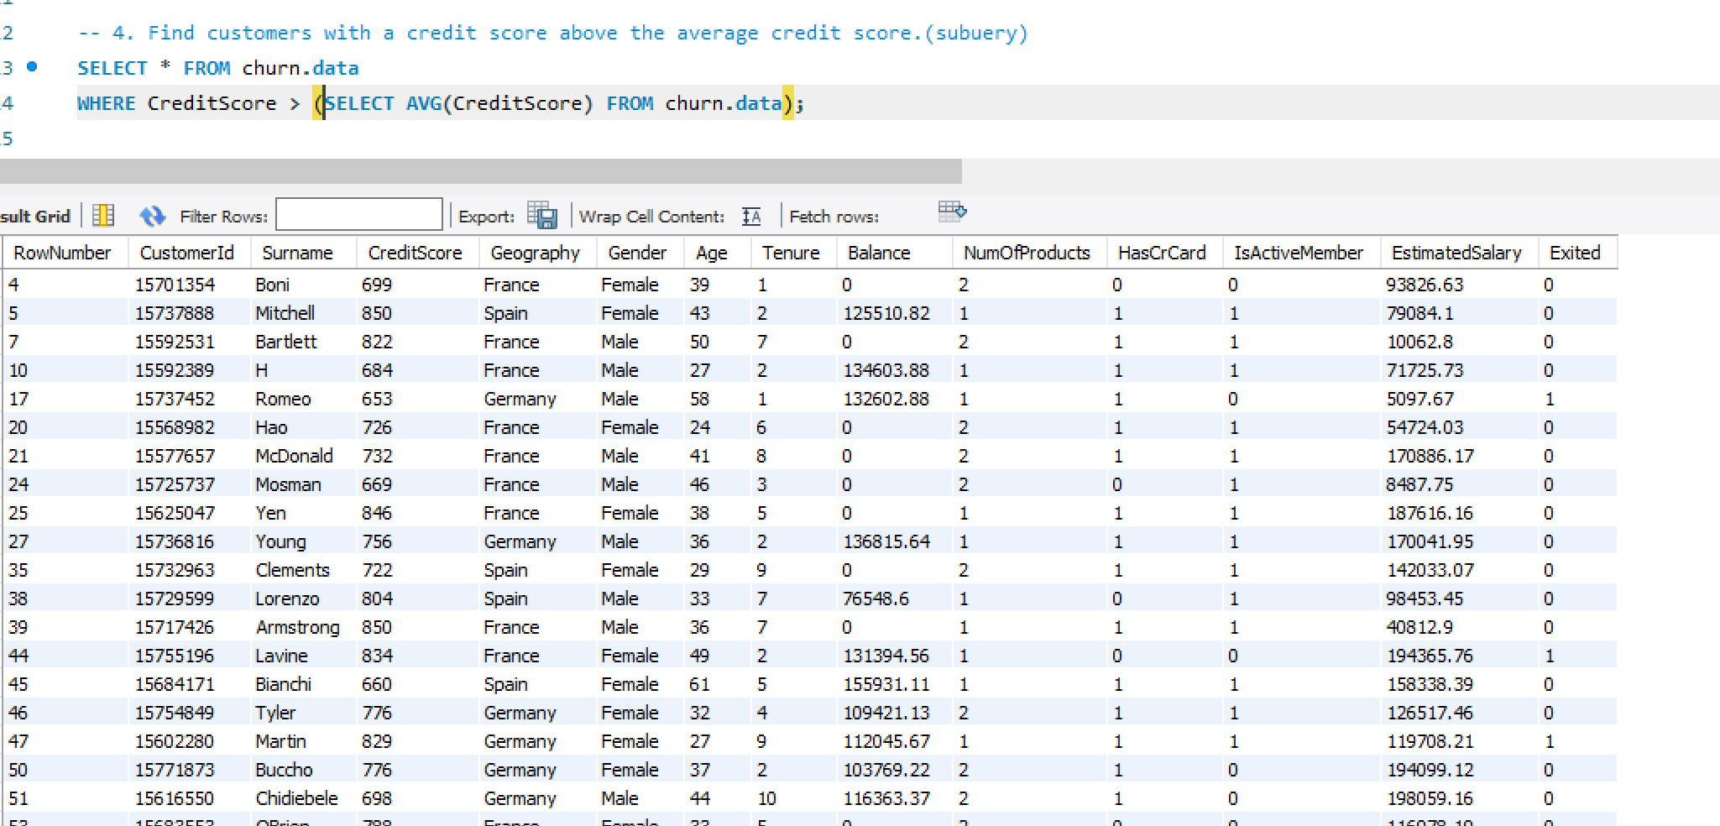
QUESTION NO: 4

Slide 8
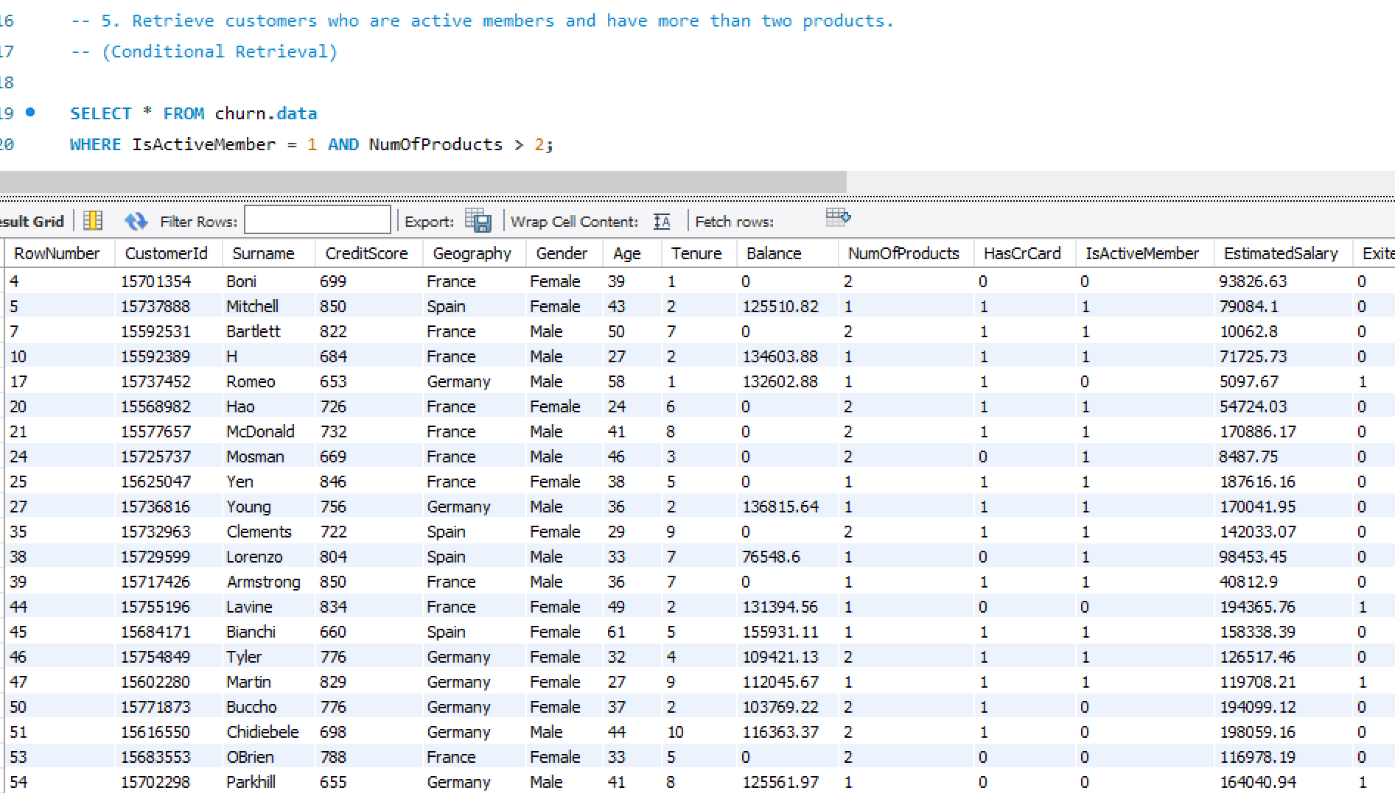
QUESTION NO: 5

Slide 9
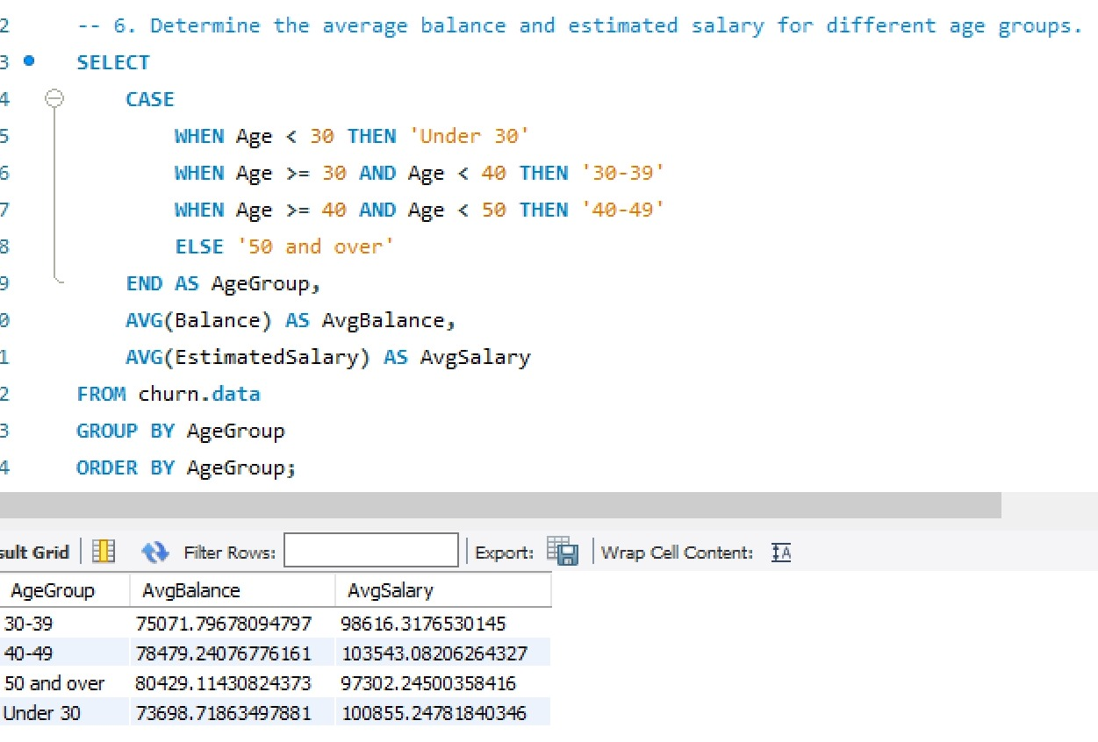
QUESTION NO: 6

Slide 10
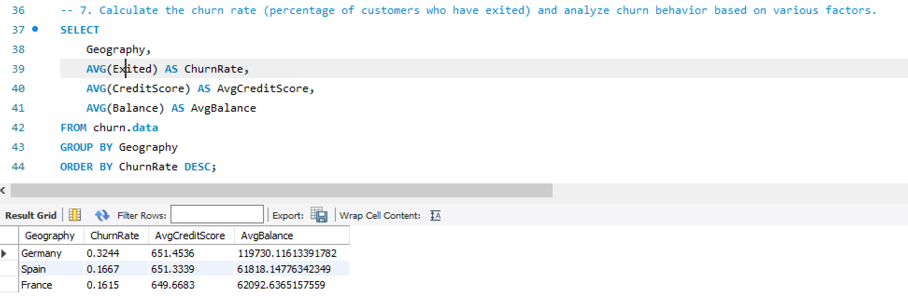
QUESTION NO: 7

Slide 11
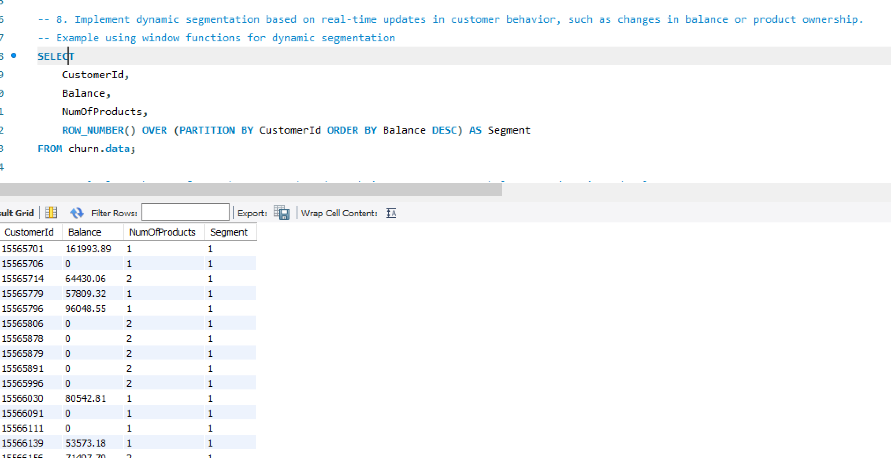
QUESTION NO: 8

Slide 12
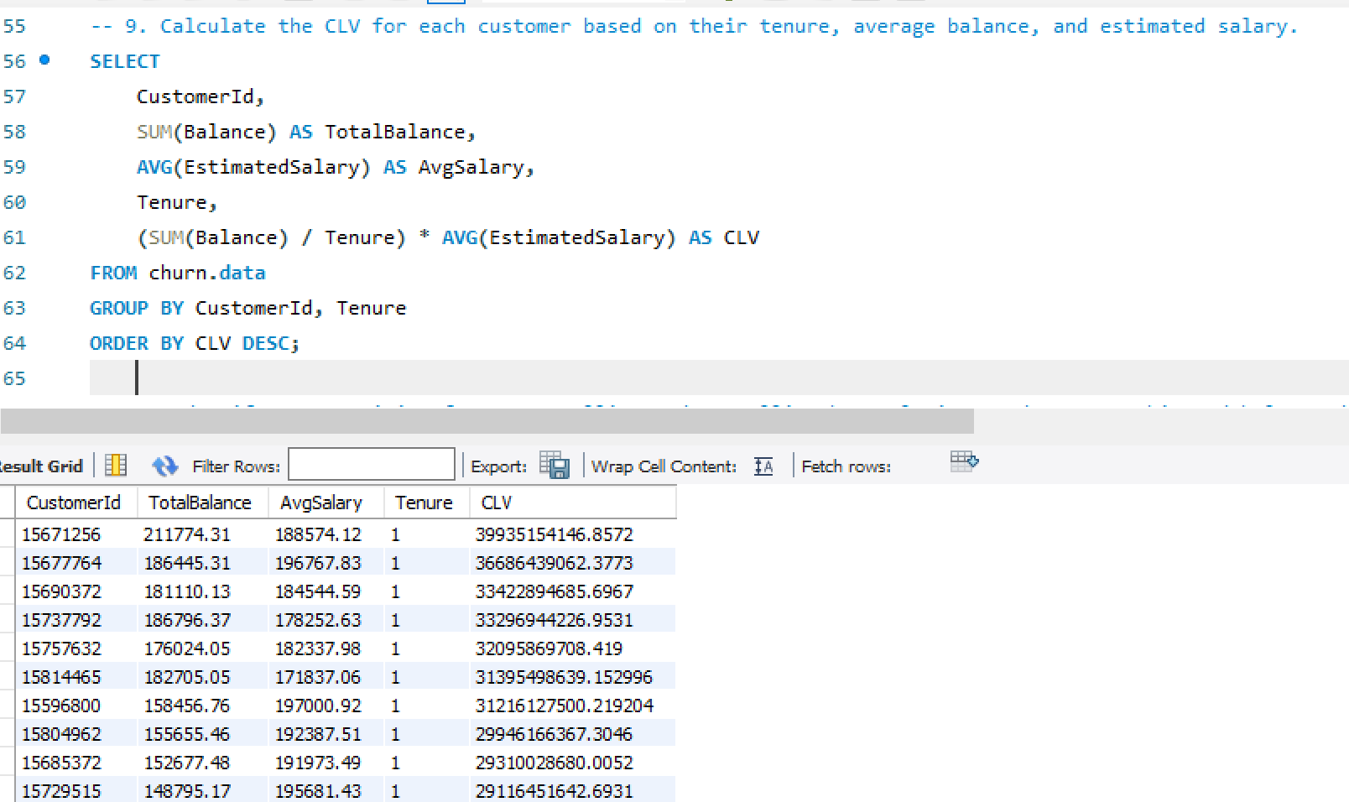
QUESTION NO: 9

Slide 13
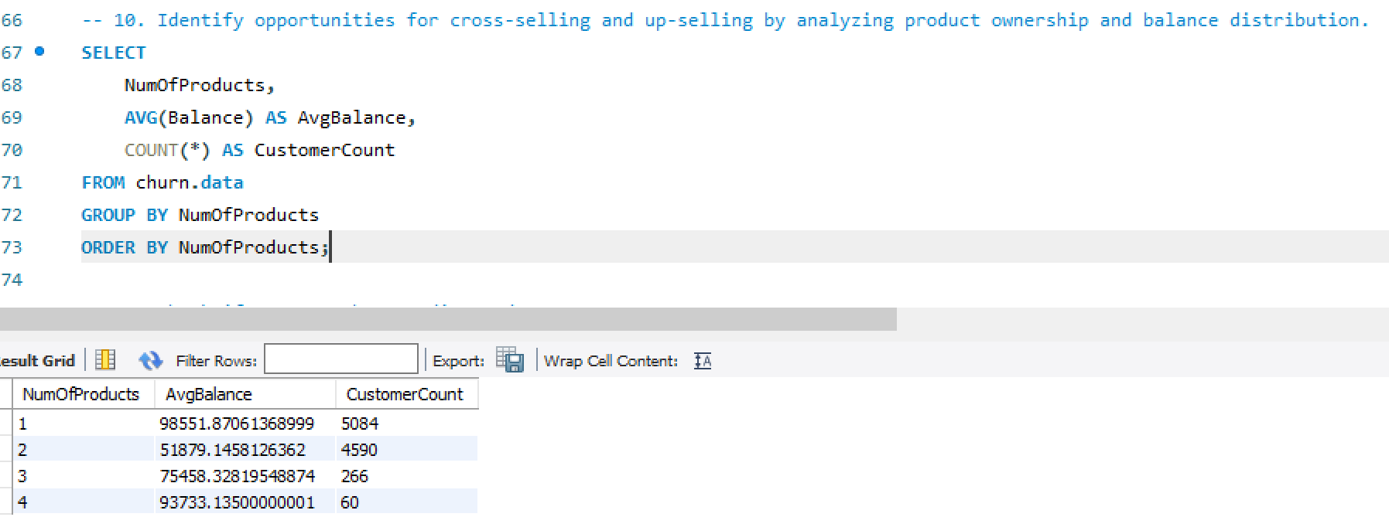
QUESTION NO: 10

Slide 14
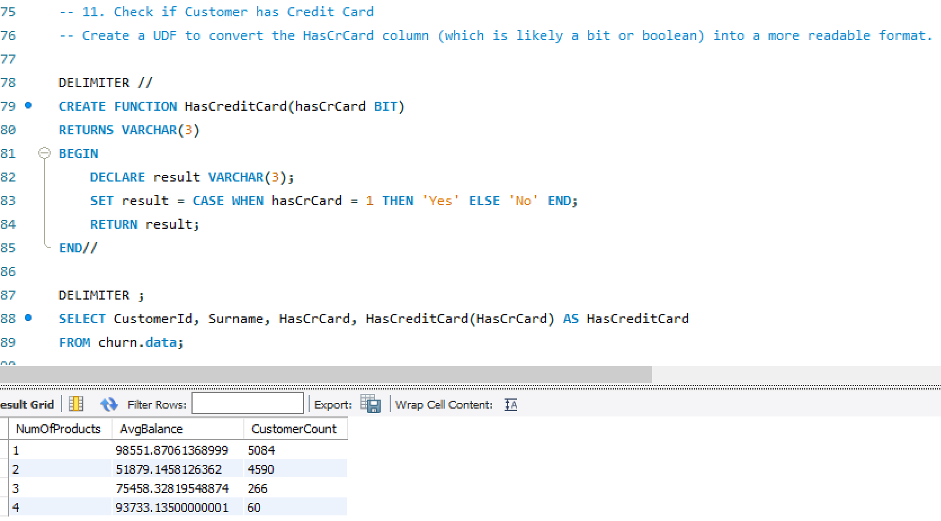
QUESTION NO: 11

Slide 15
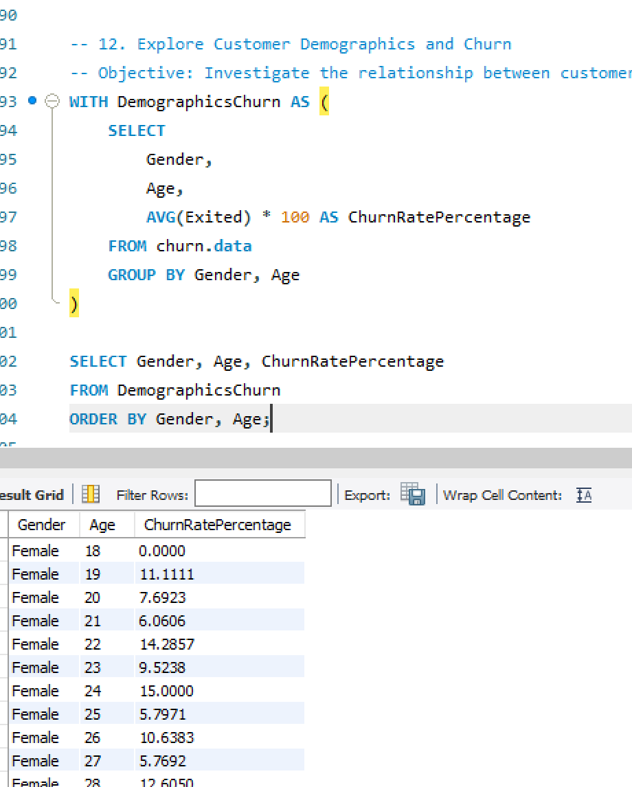
QUESTION NO: 12

Slide 16
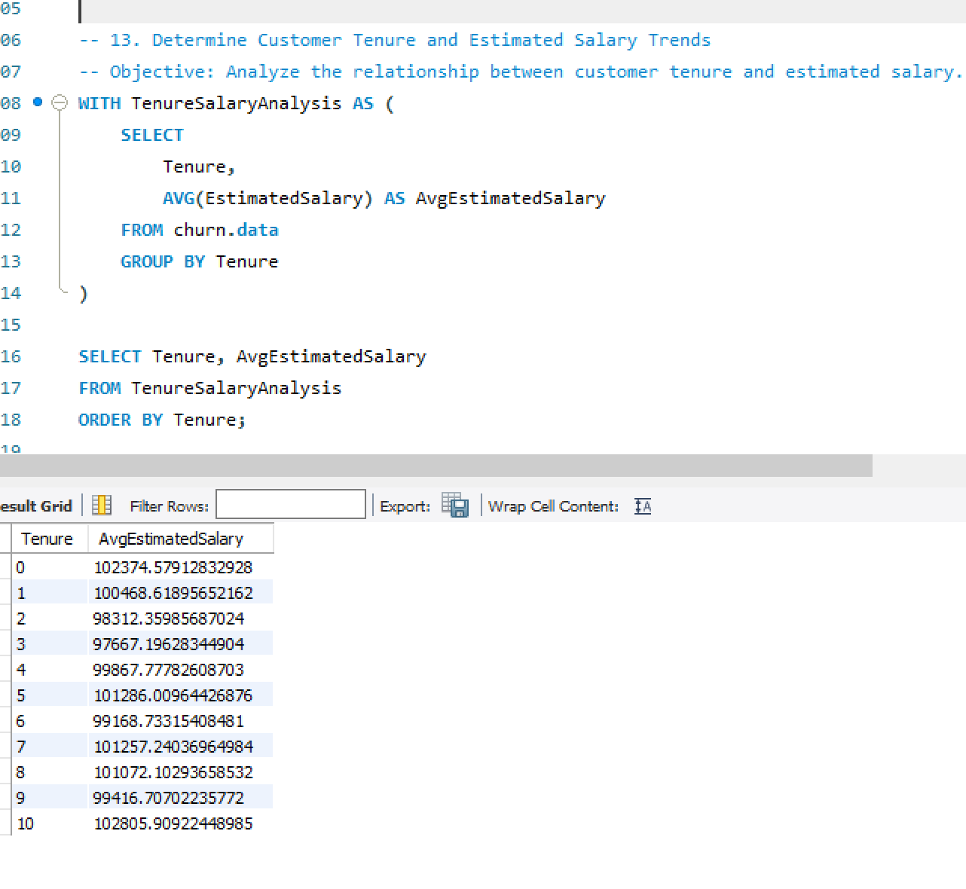
QUESTION NO: 13

Slide 17
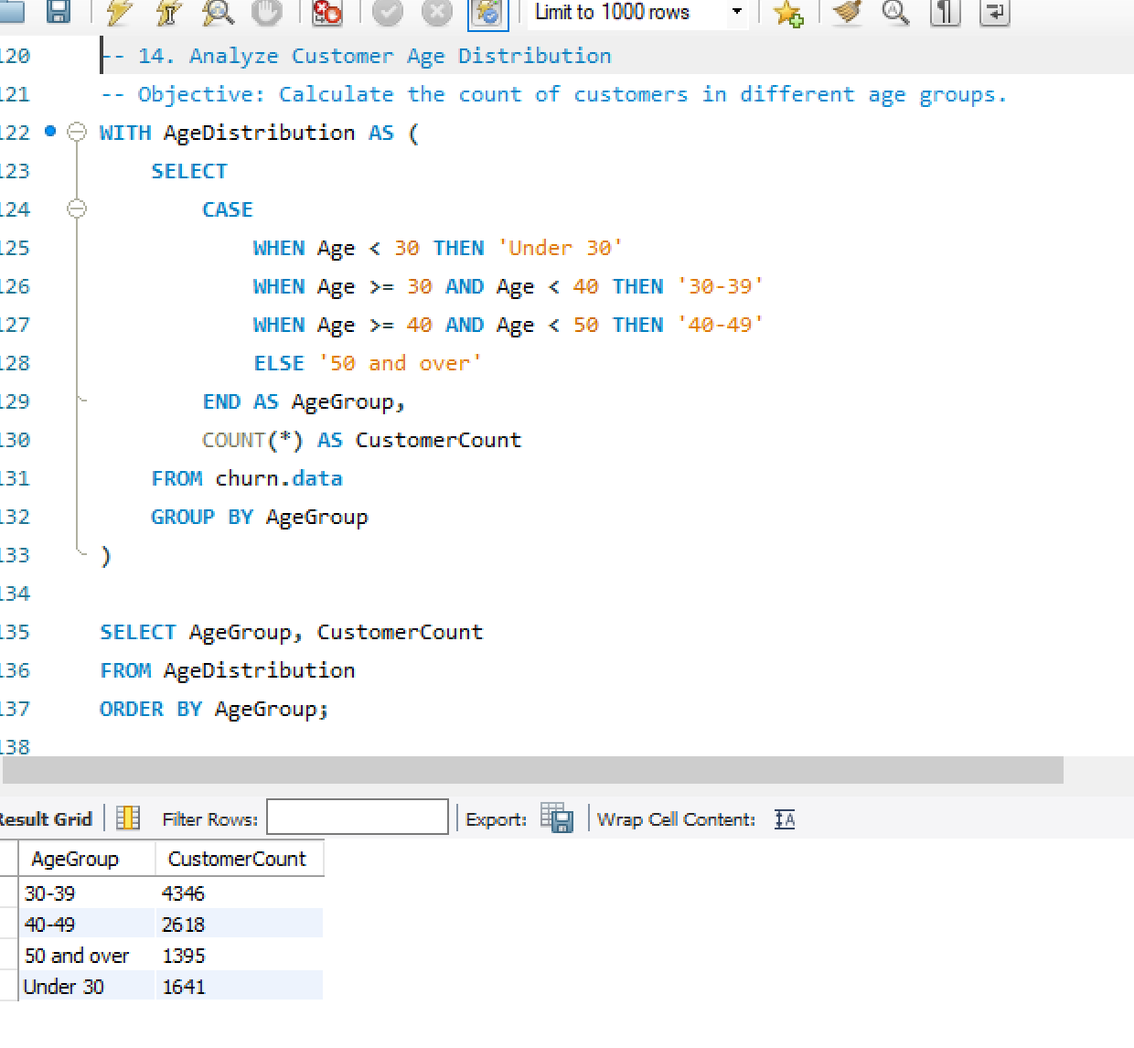
QUESTION NO: 14

Slide 18
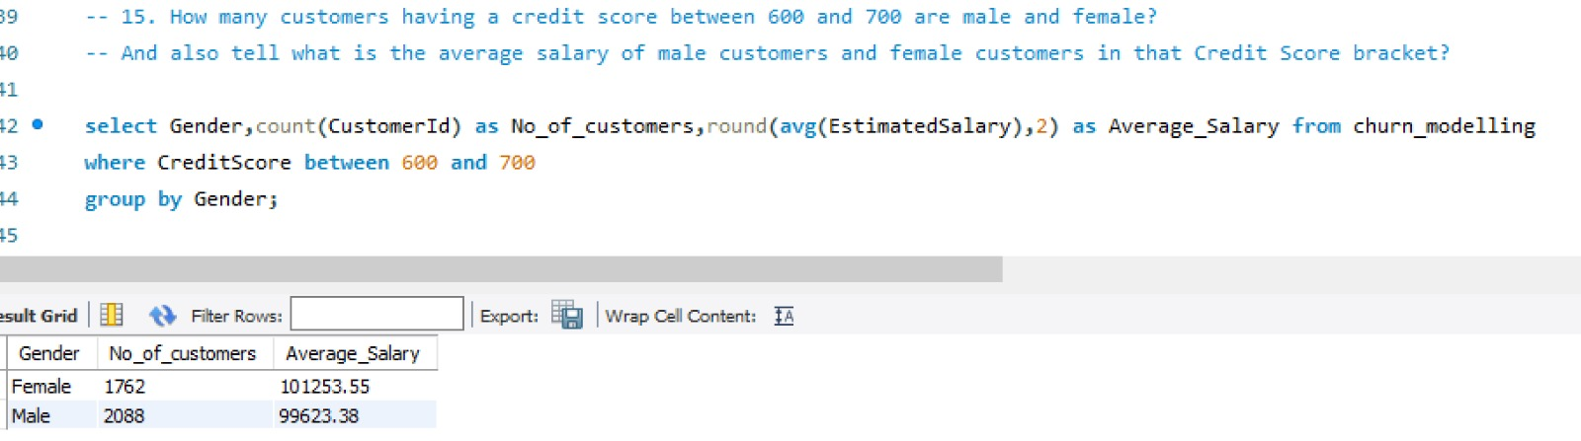
QUESTION NO: 15

Slide 19
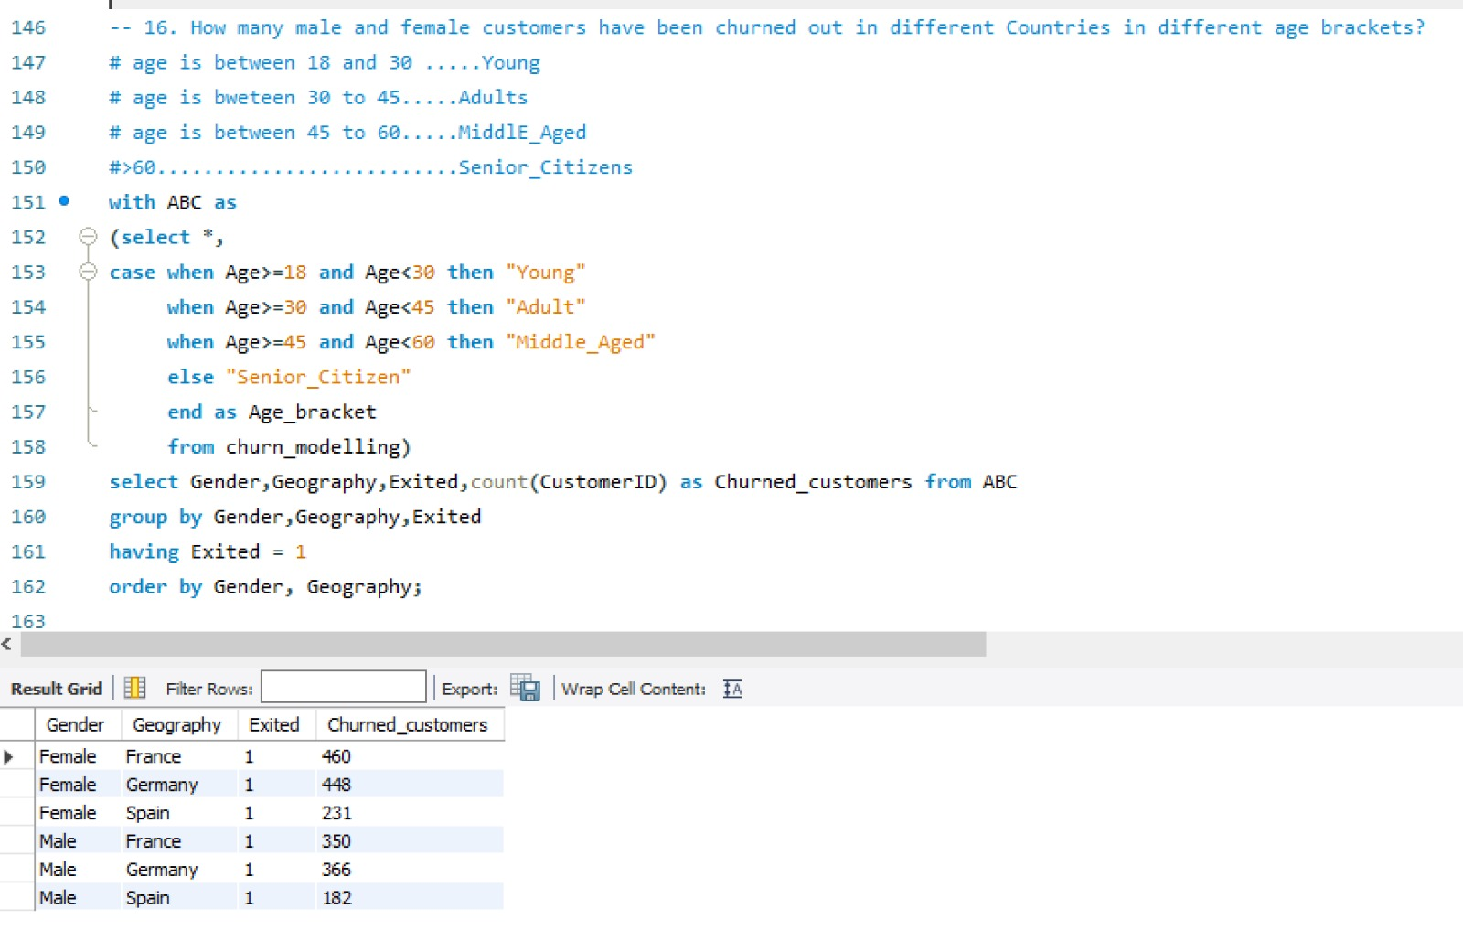
QUESTION NO: 16

Slide 20
CONCLUSION
In this project, we conducted Data Analysis on Churn modeling dataset SQL queries in SSMS. The objective was to extract meaningful insights and metrics from the Dataset. We performed various tasks such as joining tables, Aggregating Data, Filtering Records and Sorting results to fulfil specific analysis requirements.
Throughout the project, we demonstrated proficiency in SQL query writing, leveraging a variety of SQL functions, clause, Operators, Analyze the dataset effectively. We Utilized Common Table Expressions(CTE), Aggregation Functions (eg: SUM,AVG) and Local Operations to extract insights such as Total revenue, Top-selling categories, and Customer behavior patterns.

Slide 21
EXPLORATORY DATA ANALYSIS ON THE churn DATA

Slide 22
OBJECTIVES
Importing all the necessary modules.
Importing the data from an external source into the Python environment.
Renaming the variables as per the Naming conversion.
Performing necessary Datatype Conversions on the data.
Checking the relevant and irrelevant variables in the first phase of EDA.
Data Duplicacy: Chech if their is duplicate data or not: DDT ( DataDuplicacy Treatment)
Missing Values Treatment.
Separating the categorical Variables and Numerical variables into two different datasets for Data Preparations for Data Analysis.
Filling missing values in Numerical data with the Median values.
Filling missing values in Categorical data with the Mode values.
Visualizing relationship of variables using Matplotlib.pyplot
Outlier Treatment.

Slide 23
Importing all the necessary modules.
To importing necessary modules in python, we use “import” statement followed by the name of the module.
numpy : it is used for numerical computing. It provides support for large, multi-dimensional arrays and matrices. In numpy data structure allows Broadcasting and Vectorization
Importing numpy: import numpy as np
pandas: it is a powerful library in python for data manipulation and analysis. It provides data structure like data frame and series.
Importing pandas: import pandas as pd
Matplotlib.pyplot : which is used for creating static,interactive and visualization in python.

Slide 24
Matplotlib offers a wide range of plotting functions to create various types of plots such as Line plot, Scatter plot, Bar plot, Histogram and Pie chart.
Importing matplotlib: import matplotlib.pyplot as plt
Datetime: for the datetime data we import datetime.
Importing datetime : import datetime as dt
seaborn : it is a statistical data visualization module.
Seaborn simplifies the creation of complex visualization.
Box plot, Tree map, Heat maps are used to check correlations between multiple variables.
Importing seaborn : import seaborn as sns
Statsmodels: This module provides a high-level interface for specifying statistical modules using a formula.

Slide 25
Importingstats models : import statsmodels.formula.api as smf
Sklearn: it can implement and evaluate a wide range of ML models with ease, leveraging its robust and efficient algorithms and utilities.
Importing Sklearn :fromsklearn import datasets, linear_model
Importing Machine Learning modules:
Logistic Regression:
from sklearn.linear_model import LogisticRegression
from sklearn.metrics import accuracy_score,confusion_matrix,classification_report,roc_auc_score,roc_curve
from sklearn.metrics import f1_score, roc_auc_score, confusion_matrix, accuracy_score

Slide 26
Decision Tree: from sklearn.tree import DecisionTreeClassifier from sklearn.metrics import confusion_matrix from sklearn.tree import DecisionTreeClassifier, export_graphviz, export_text from sklearn.neighbors import KNeighborsClassifier from sklearn.model_selection import GridSearchCV, train_test_split from sklearn.preprocessing import StandardScaler, minmax_scale K-Nearest Neighbors Classifier: from sklearn.neighbors import KNeighborsClassifier from sklearn.model_selection import GridSearchCV, train_test_split from sklearn.preprocessing import StandardScaler, minmax_scale Random Forest Classifier: from sklearn.ensemble import RandomForestClassifier Naive Bayes Algorithm: from sklearn.naive_bayes import GaussianNB gnb = GaussianNB()

Slide 27
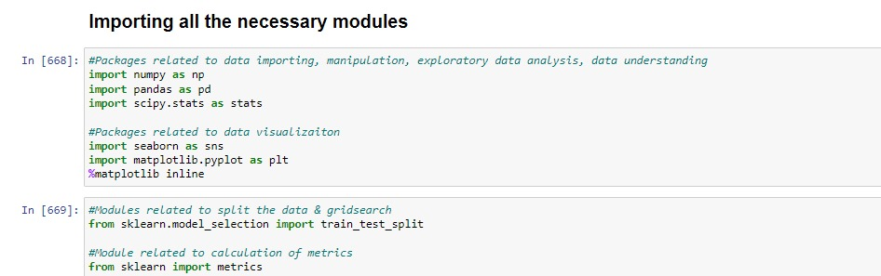
CODE

Slide 28
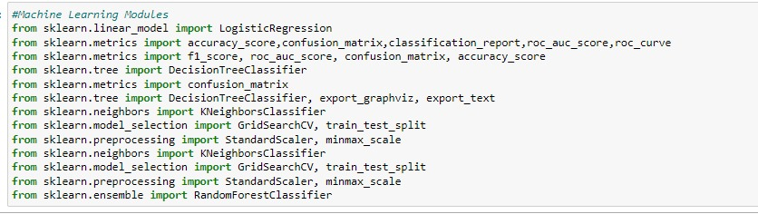

Slide 29
Importing the data from an external source into the Python environment
To import data from an external source into a python environment, we use various methods depending on the type and format of the data.
In this project data is in the format of csv file. To read csv files using the read_csv() function

Slide 30
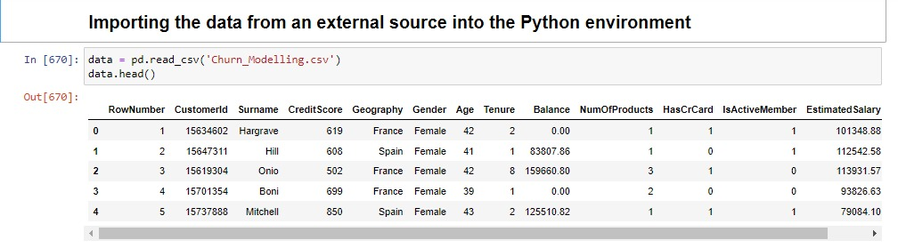

Slide 31
Renaming the variables as per the Naming conversion.
According to the naming conversion :
Names should be starting with alphabets.
Do not use special characters except underscore.
There is no spacing between the names.

Slide 32
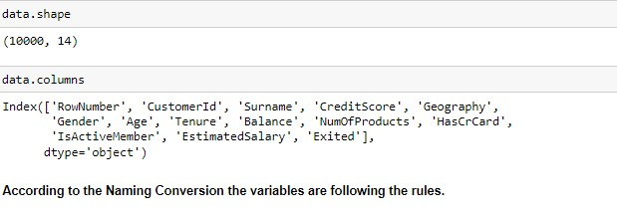

Slide 33
In this Datafollows the naming conversion
Getting the summary of the data frame , data.info() is used to get the concise summary of the Dara frame.
It provide information such as :
The total number of entries in each column.
The data type of each column.
The count of non-null values in each column.
The memory usage of the data frame

Slide 34
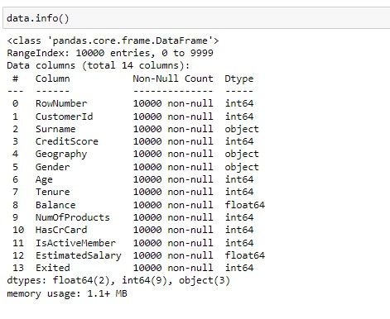

Slide 35
Data Duplicacy : Check if their is duplicate data or not: DDT (Data Duplicacy Treatment)
In this churn data there is no duplicate values. The data contain 10000 records and 14 variables.

Slide 36
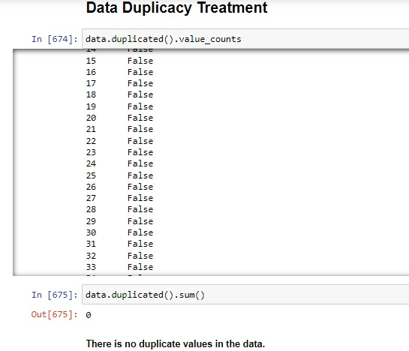

Slide 37
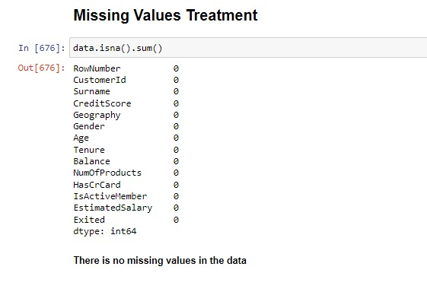
MISSING VALUE TREATMENT There is no missing values in this data.

Slide 38
checking the value count and nunique of categorical variable
In the first phase of Exploratory Data Analysis (EDA), determining relevant and irrelevant variables is crucial for understanding the dataset and shaping further analysis.
Data.nunique() is used to count the number of unique values in a data frame or series.
Value _counts() is used to count the occurrences of unique values .

Slide 39
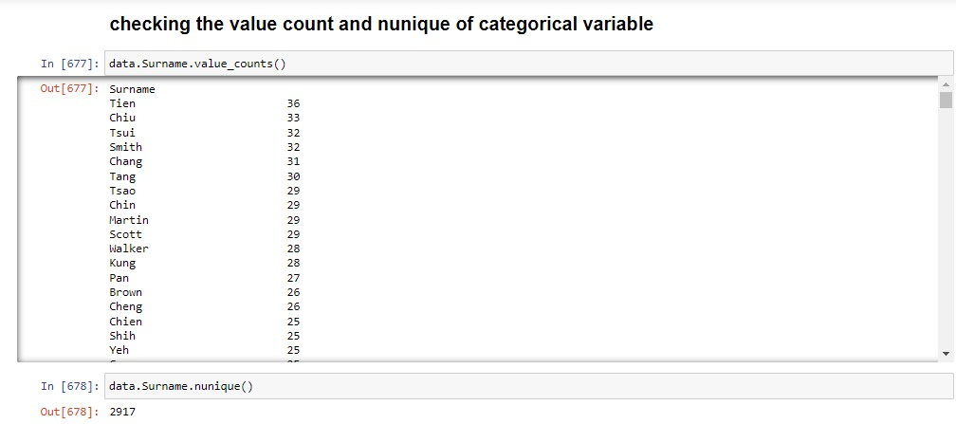
CODE

Slide 40
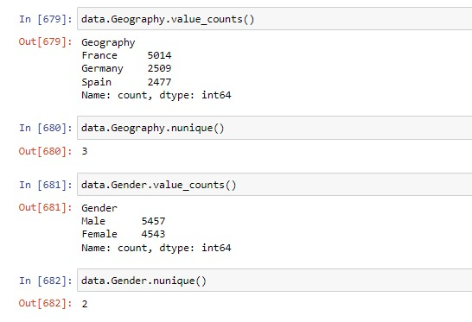

Slide 41
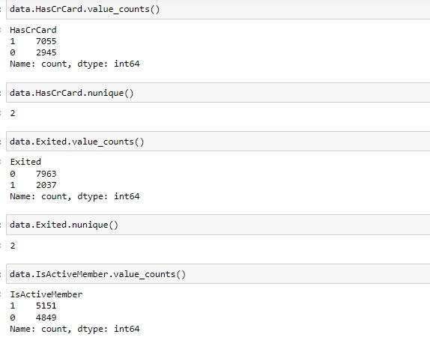

Slide 42
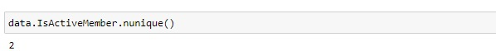

Slide 43
Visualizing relationship of variables using Matplotlib.pyplot.
Matplotlib.pyplot : which is used for creating static, interactive and visualization in python.
Matplotlib offers a wide range of plotting functions to create various types of plots such as Line plot, Scatter plot, Bar plot, Histogram and Pie chart.
Line plot: Line plot display data points connected by straight line segment. It commonly used to visualize the relationship or trends.
Scatter plot: Scatter plot is used to show the correlation between two numerical variables.
Bar plot: Bar plot is used for comparison analysis. It shows the relation between one numerical variable and one categorical variable.
Histogram: Histograms are very helpful to see the frequency distribution by only numerical variable.
Pie chart: used for showing the percentage distribution of a numerical variable by one categorical variable.

Slide 44
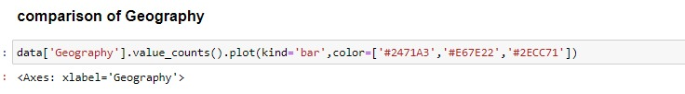
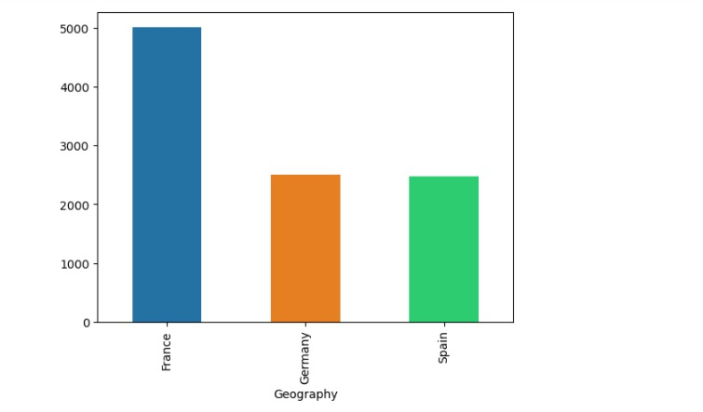

Slide 45
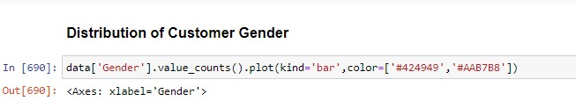
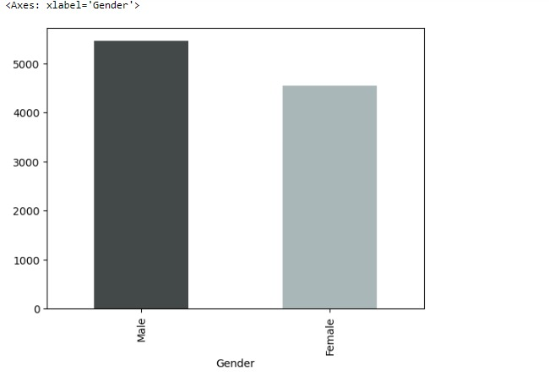

Slide 46
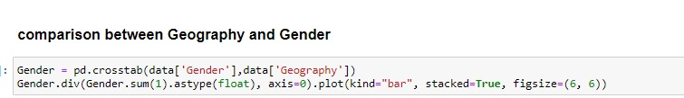
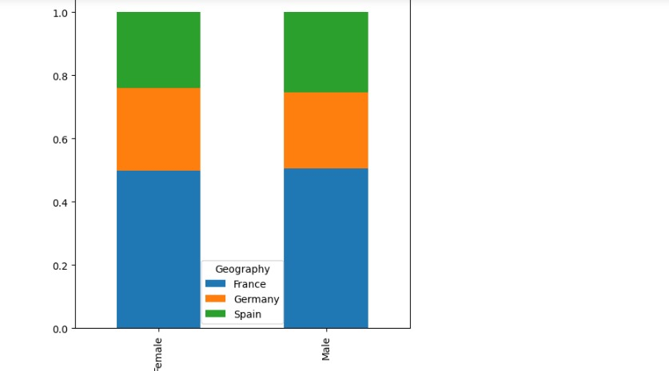

Slide 47
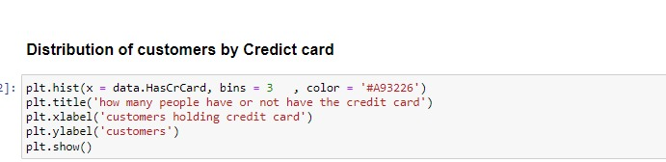
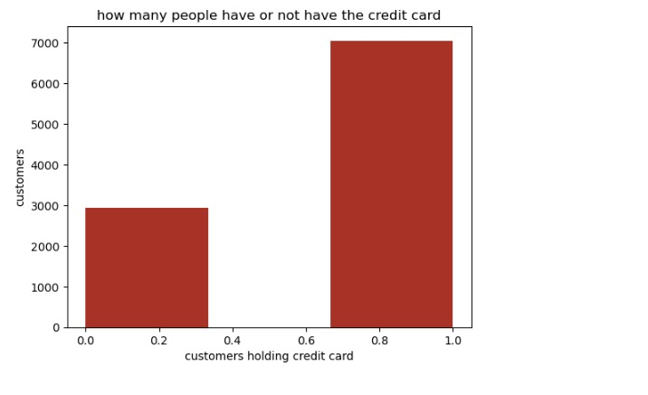

Slide 48
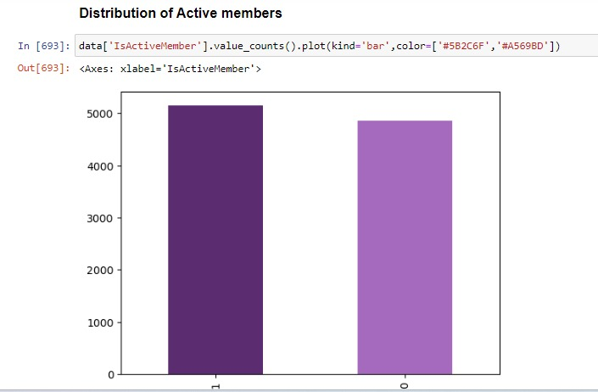

Slide 49
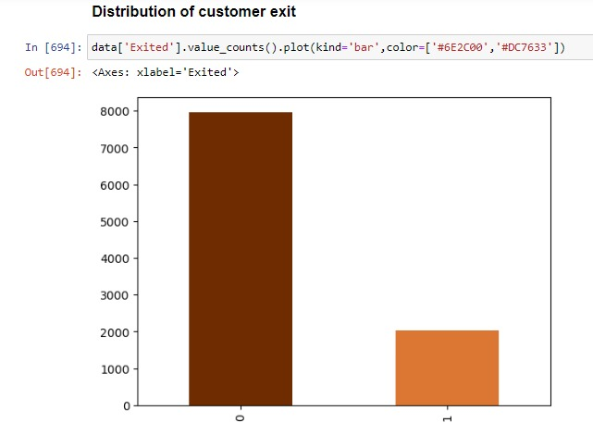

Slide 50
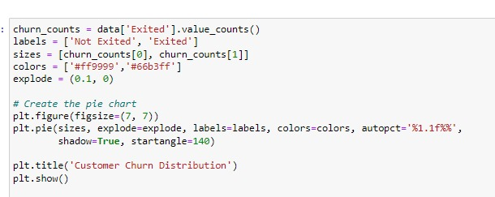
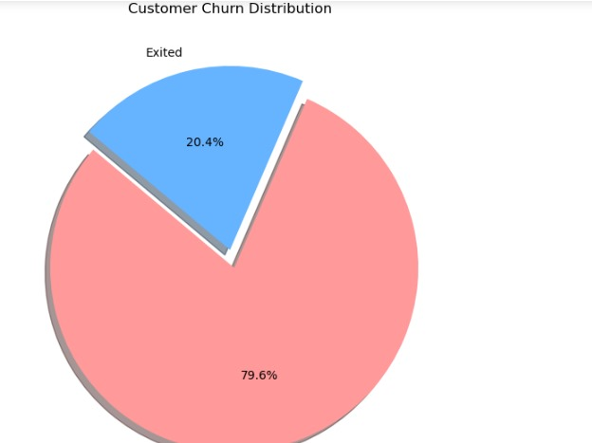

Slide 51
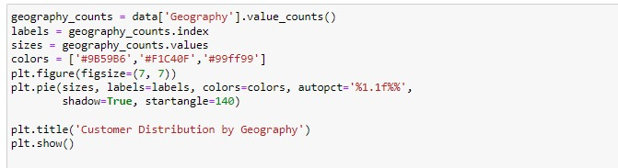
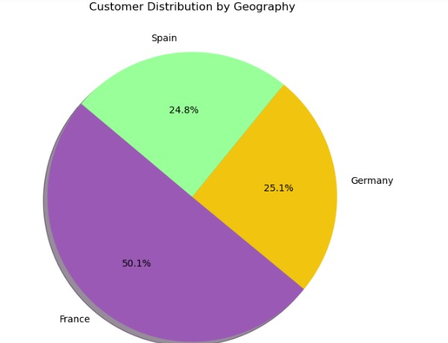

Slide 52
Separating the categorical Variables and Numerical variables into two different datasets for Data Preparations for Data Analysis There 3 categorical variable and 11 numerical variables

Slide 53
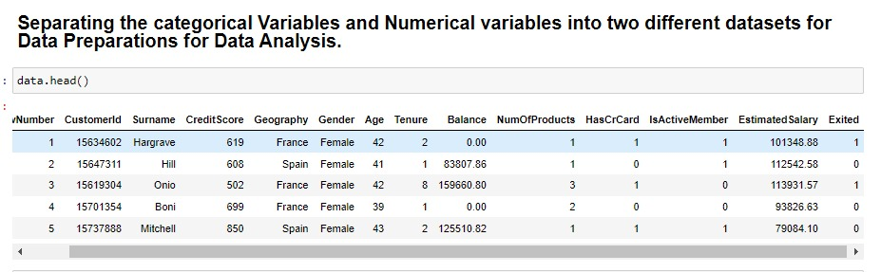

Slide 54
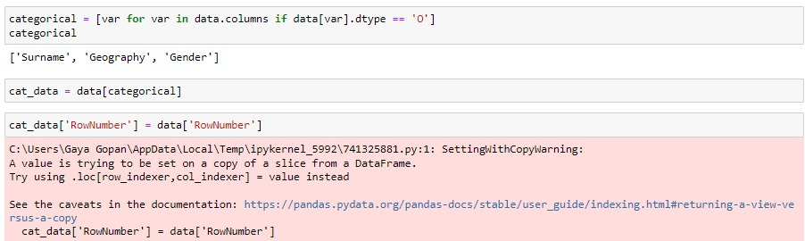

Slide 55
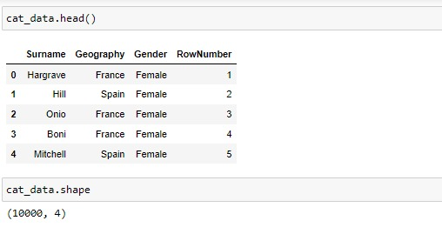

Slide 56
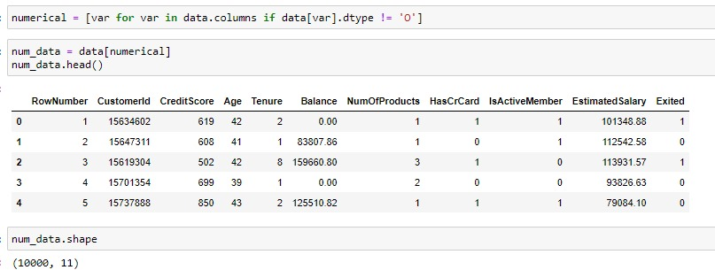

Slide 57
OUTLIER TREATMENT.
In python outlier is a data point that significantly differ from other observations in a dataset.
Outlier is a value either very large or either very small.
To perform outlier treatment using the interquartile range (IQR) method .
Mean of the data gets affected by the outlier and median not affected much.

Slide 58
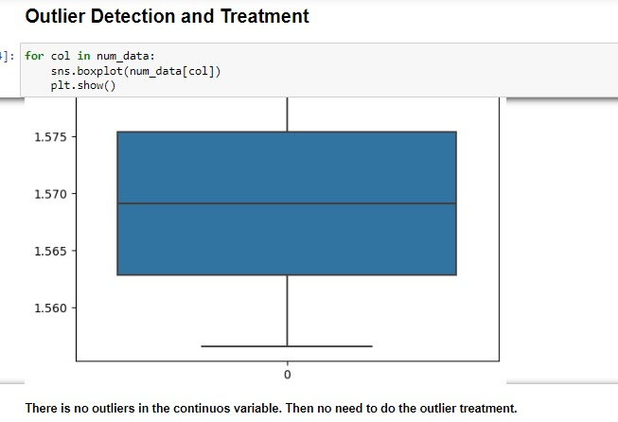
There no outliers in our data.

Slide 59
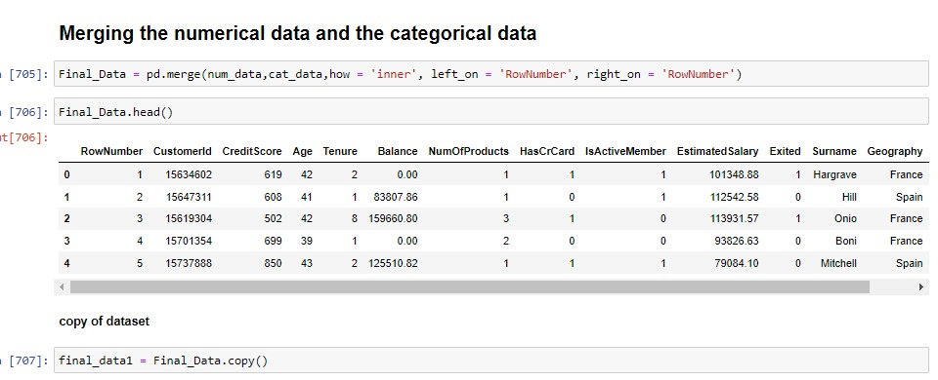
Merging the numerical data and the categorical data

Slide 60
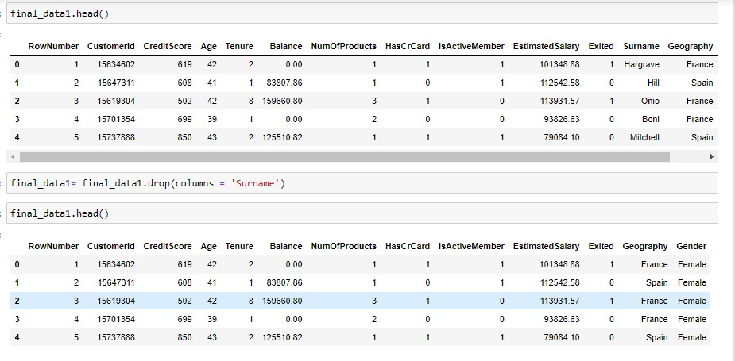
After merging the numeric and categorical data we get Final Data. Make a copy of final data to safe the original data.

Slide 61
ONE-HOT ENCODING
One-hot encoding is a technique used to convert categorical variables into a numerical format that can be used in machine learning models. It creates a binary column for each category and assigns a 1 or 0 to indicate the presence of a category in a given sample.
creating dummy variables is a crucial step in preprocessing categorical data for machine learning models, ensuring that the data is in a suitable numerical format without imposing any unintended order or hierarchy.

Slide 62
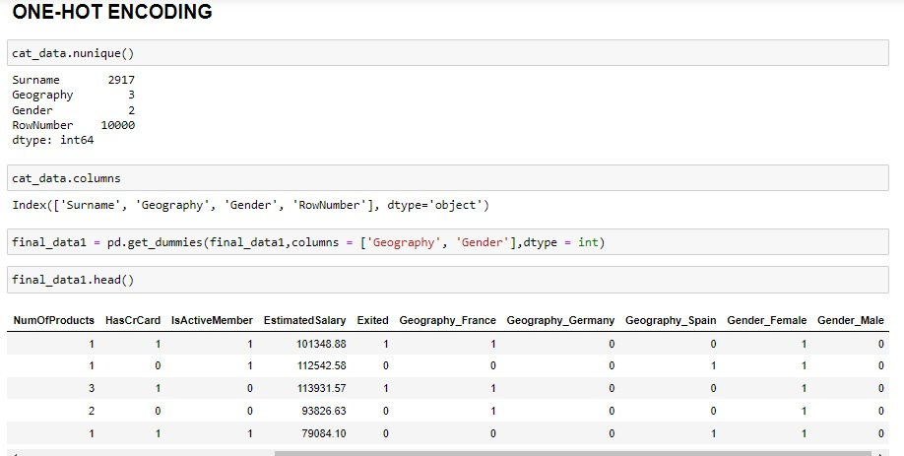
CODE

Slide 63
Feature Engineering
Feature Engineering is a part of EDA in which we try to remove the less important feature and take only the relevant and important variable or feature.
Correlation Analysis :
The correlational coefficient indicates the strength and direction of the relationship.
The range of correlational analysis is -1 to 1.
1 indicates perfect positive correlation.
-1 indicates perfect negative correlation.
0 indicates no linear relationships.
Selecting the important feature by choosing a cut of value of 0.03

Slide 64
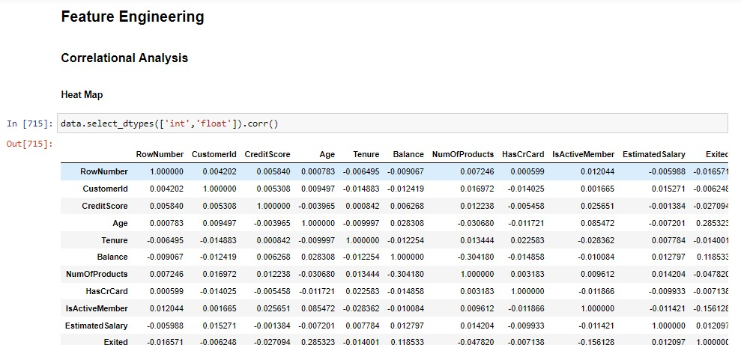

Slide 65


Slide 66


Slide 67


Slide 68


Slide 69
Splitting the final dataset into Training and Testing dataset
Divide the dataset into separate subset for Training, Validation, Testing dataset.
Training dataset :
The largest portion of the dataset (70-80% of total dataset).
Learn patterns, relationships and characteristics from the set.
Validation dataset :
10-15% of the dataset.
Optimizing model performance without overfitting the training data.
Testing dataset :
Evaluating the final model’s performance on unseen data.
10-15% of the total data.

Slide 70


Slide 80
THANK YOU - Gayagopan - Jyothi -Dhivya

